Slide 1
2. Speech Signal Representations

Slide 2
Outline
2.1 Short-Time Fourier Analysis
2.2 Accoustical Model of Speech Production
2.3 Linear Predictive Coding
2.4 Cepstral Processing

Slide 3
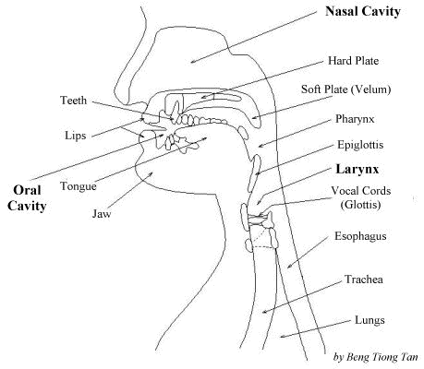
Human speech production apparatus

Slide 4
Physiology of the Ear
Three sections in human ear
  Outer ear
    Consists of the external visible part and external auditory canal that forms a tube along which sound travels.
  Middle ear
    An air-filled cavity, air travels to the middle ear cavity along the tube that connects the cavity with the nose and throat.
  Inner ear
    Inner ear for sound perception is the cochlea, which communicates directly with the auditory nerve, conducting a representation of sound to the brain.

Slide 5
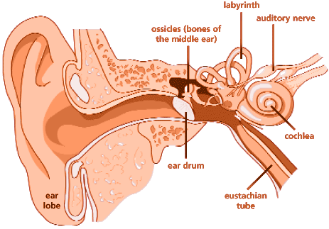
Physiology of the Ear (cont.)

Slide 6
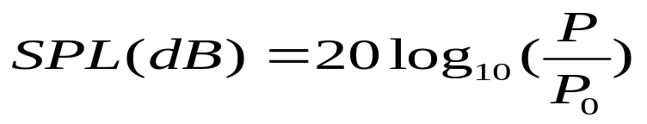
Sound Pressure Level (SPL)
Sound pressure level(SPL) is a measure of absolute sound pressure P in dB
, where 0 dB corresponds to the threshold of hearing (TOH).(20 µPa=N/m² roughly the sound of a mosquito flying 3 m away).
The faintest audible sound is arbitrarily assigned a value of 0 dB, and the loudest sounds that the human ear can tolerate are about 120 dB

Slide 7
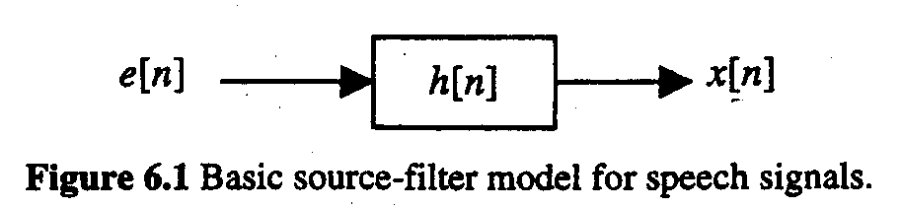
前言
This chapter presents several representations for speech signals useful in speech coding, synthesis, and recognition.
Source
Filter
Speech Singnal
Once the filter has been estimated, the source can be obtained by passing the speech signal through the inverse filter.

Slide 8
2.1 SHORT-TIME FOURIER ANALYSIS
Spectrogram :
A special two-dimensional representation that displays time in its horizontal axis and frequency in its vertical axis. A gray scale is typically used to indicate the energy at each point (t, n) with white representing low energy and black high energy.
能量少
能量多

Slide 9
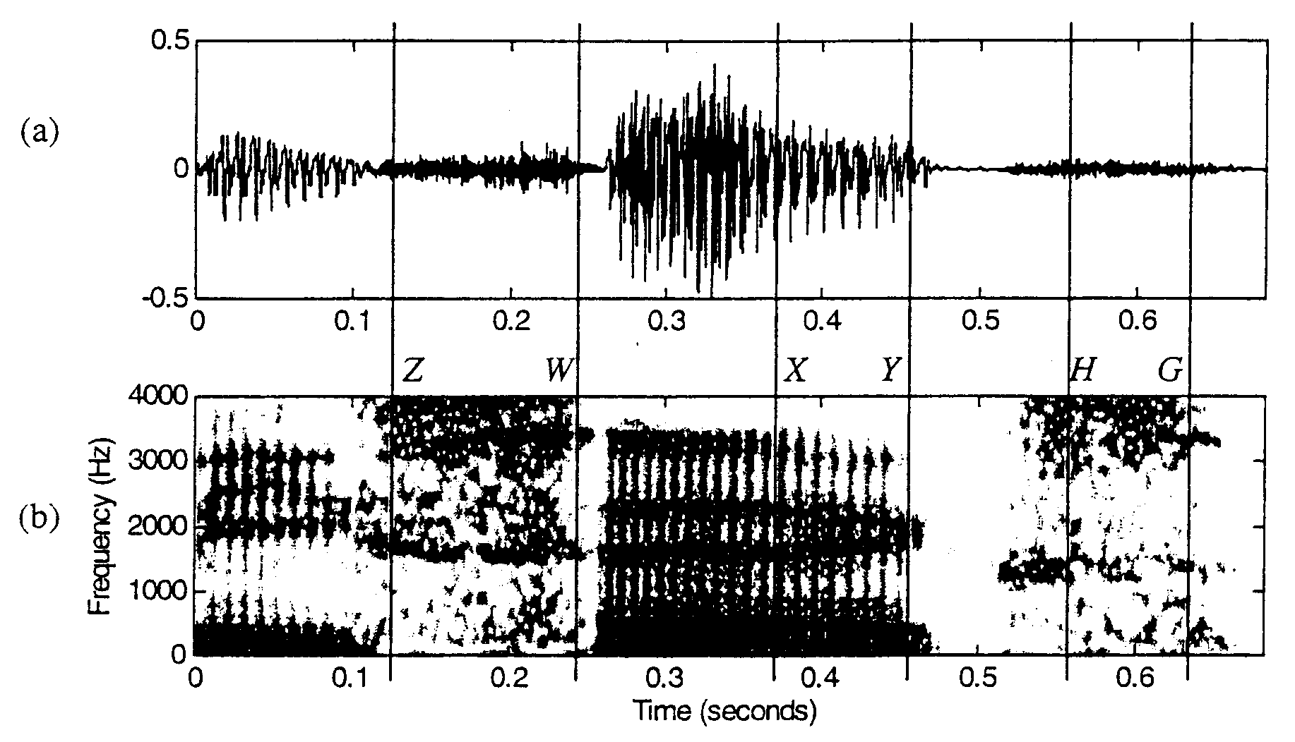
Waveform
Spectrogram

Slide 10
Random noise
Periodic Speech Signal
Random noise

Slide 11
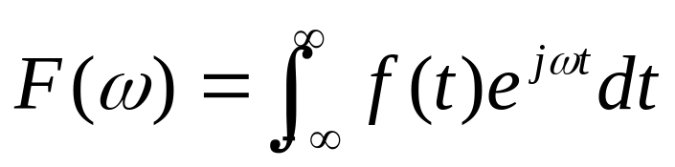
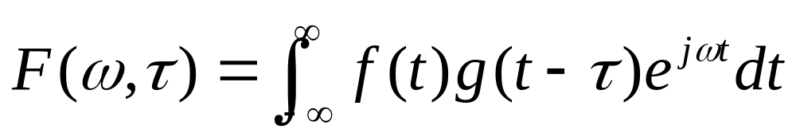
FFT vs. STFT
FFT
STFT
g(t)為視窗函數

Slide 12
小波轉換
基底是由一個原形函數的縮張與平移所形成的
適合表達高頻的突發暫態信號或是長時間緩慢變化的信號
提供了一個很有彈性的時域與頻域的解析度

Slide 13

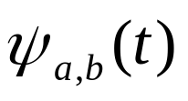
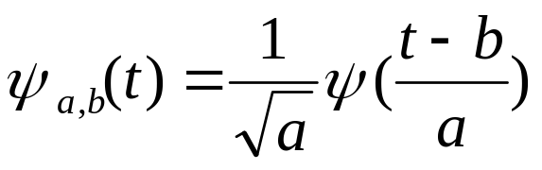

小波（Wavelet）
母小波 ：改變此函數的大小與平移可得到其餘的函數，我們又稱其餘的函數為子小波
子小波定義：

Slide 14
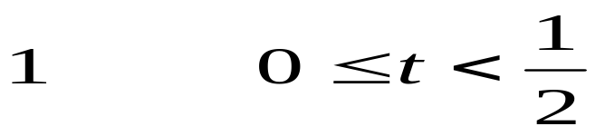
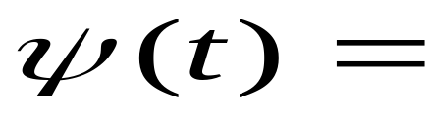
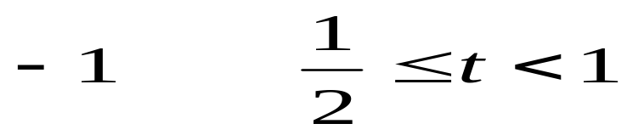
小波轉換範例
小波有很多種類，其中一種最簡單的形式為Harr 小波，其表示如下：

Slide 15
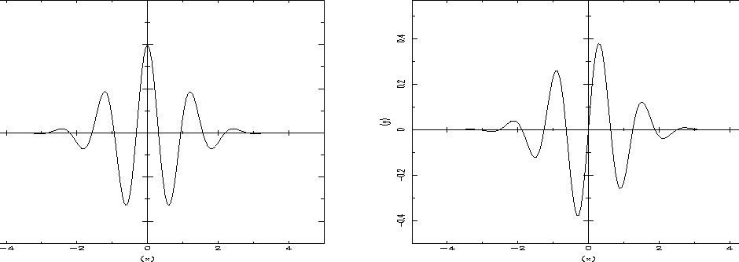
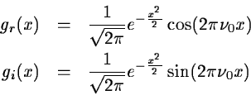
Morlet's wavelet: real part at left and imaginary part at right.

Slide 16
2.2 ACOUSTICAL MODEL
OF SPEECH PRODUCTION
聲音是利用聲波在空氣中的震動來傳播，而傳播的途中則包含許多的變數，我們必須將聲波做聲道形狀、長度之時變性，聲道壁上熱傳導及黏性摩擦之損失，聲道壁之柔軟度，嘴唇之聲音放射效應，鼻腔之耦合效應，聲道上聲音之激發效應。

Slide 17
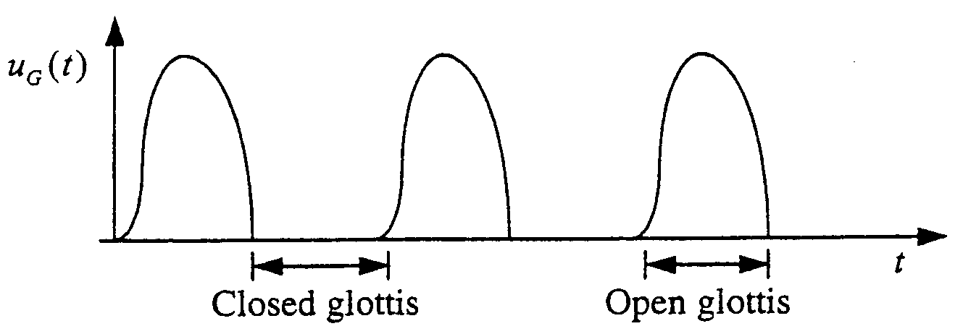
2.2.1 Glottal Excitation
The closed-phase of the oscillation takes place when the glottis is closed and the volume velocity is zero. The open-phase is characterized by a non-zero volume velocity, in which the lungs and the vocal tract are coupled.

Slide 18
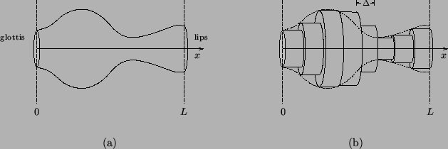

Slide 19
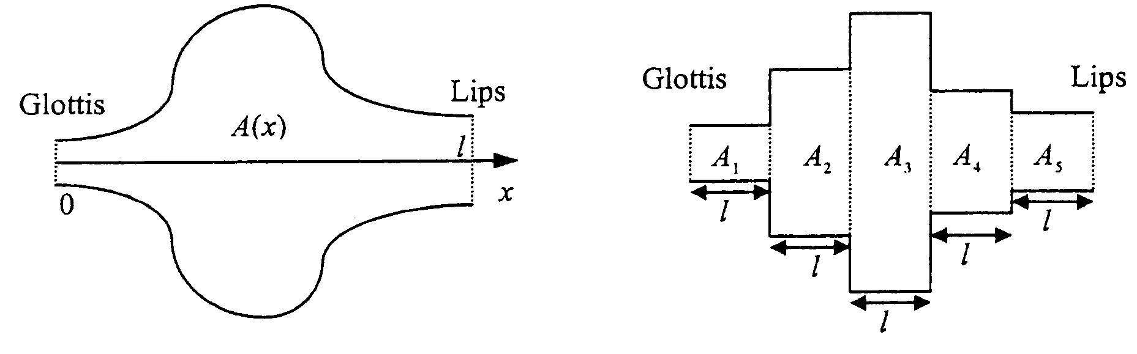
2.2.2 Lossless Tube Concatenation
聲道可模擬成一不規則，時變性截面之管道，同時假設沒有黏性及熱傳導之損失,根據質量、 動力與能量守恆定律，則聲波滿足下列方程式：

Slide 20
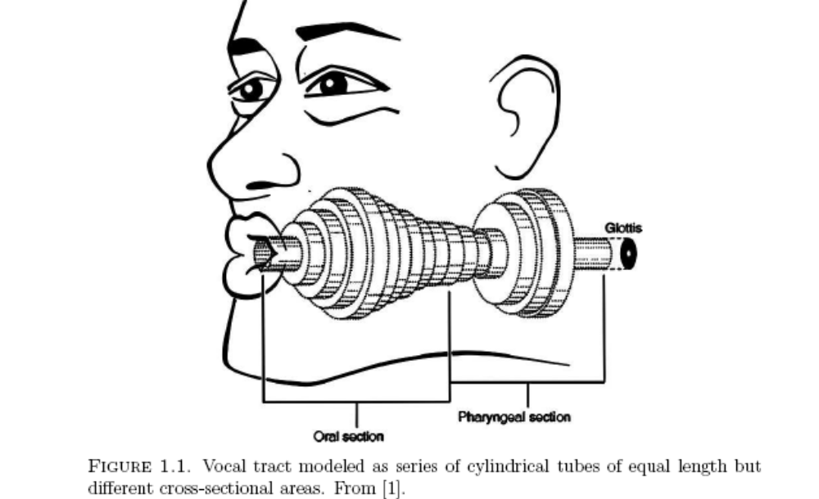
http://sal.shs.arizona.edu/~smathur/pubs/Thesis/MathurCh1.pdf

Slide 21
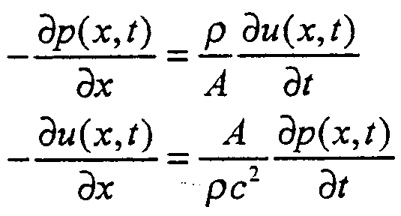

(6.9)
where p(x, t) is the sound pressure in the tube at position x and time t, u(x, t) is the volume velocity flow in the tube at position x and time t, is the density of air in the tube, c is the velocity of sound, and A is the cross-sectional area of the tube. The volume velocity of a gas flow is defined as particle velocity times the cross-sectional area of the flow, or

Slide 22
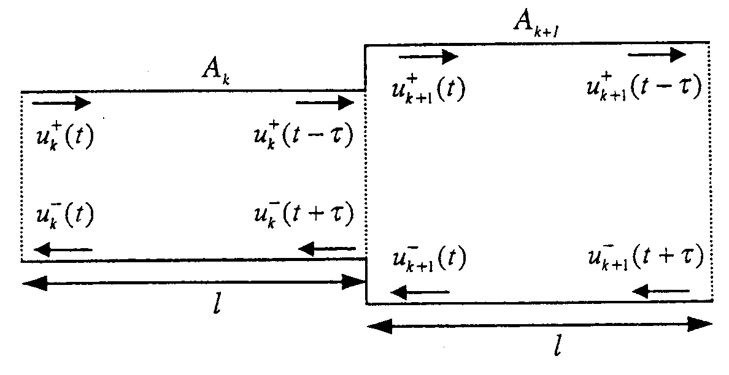
If a large number of tubes of short length are used, we reasonably expect the frequency response of the concatenated tubes to be close to those of a tube with continuously varying area function.

Slide 23
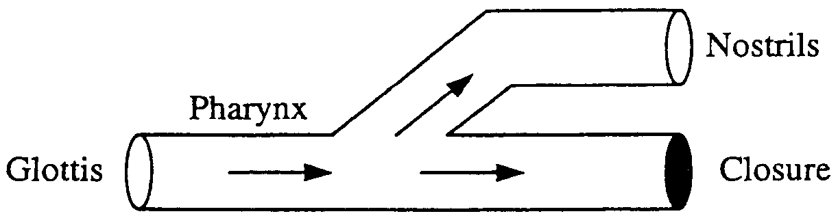
There are two branches, one of them completely closed. The set of resonances is determined by the shape and length of the three tubes. At certain frequencies, the wave reflected in the closure cancels the wave at the pharynx, preventing energy from appearing at nostrils. The result is that for nasal sounds, the vocal tract transfer function V(z) has anti-resonances (zeros) in addition to resonances.

Slide 24


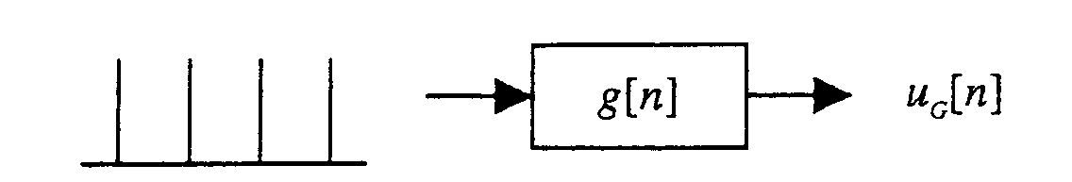
2.2.3 Source-Filter Models of Speech Production
Speech signals are captured by microphones that respond to
changes in air pressure. Thus, it is of interest to compute the pressure at the lips ,which can be obtained as
(6.17)
For voiced sounds we can model u_{G}[n] as an impulse train convolved with g[n] , the glottal pulse. Since g[n] is of finite length, its z-transform is an all-zero system.

Slide 25
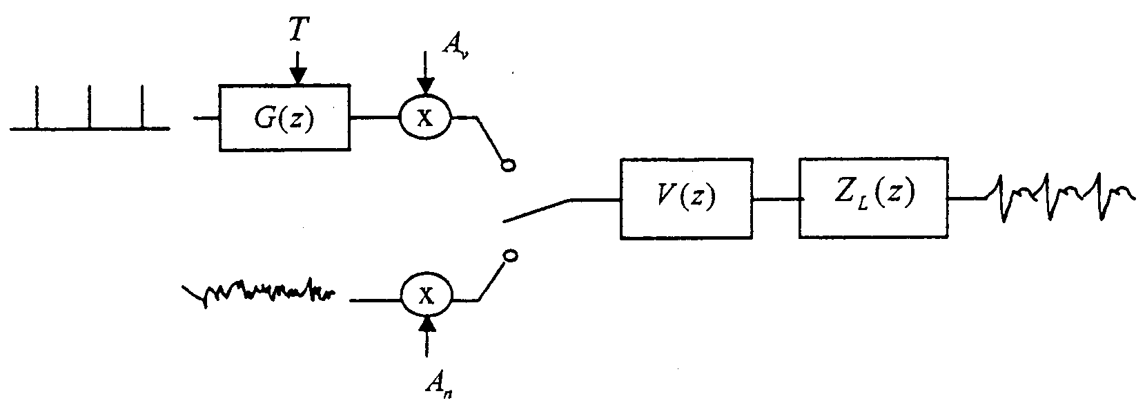
將 voiced 和 unvoiced sounds 整合

Slide 26
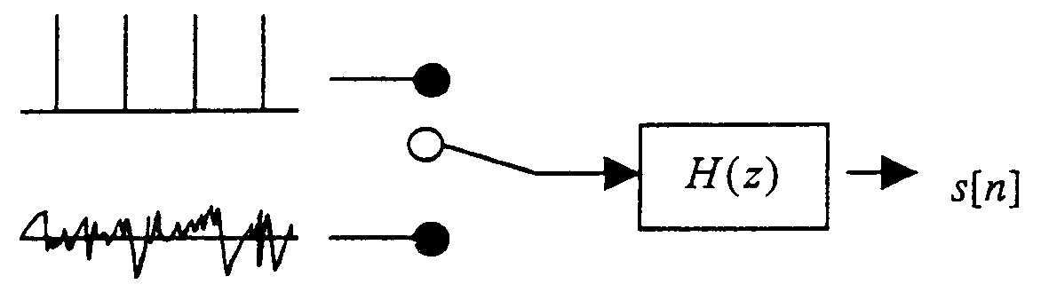
Simplify the model by grouping G(z), V(z), and Z_{L}[z] into H(Z)
Fails on voiced fricatives (contain both a periodic component and an aspirated component)

Slide 27
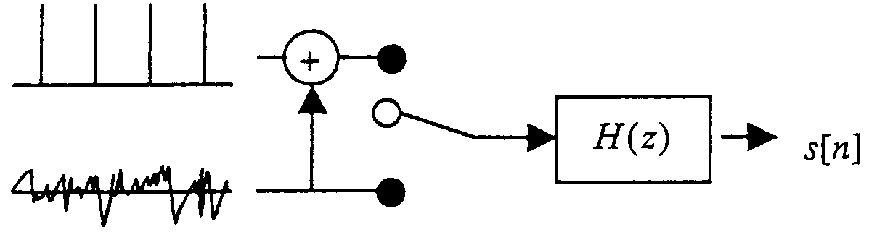
In this case, a mixed excitation model can be applied, using for voiced sounds a sum of both an impulse train and colored noise .

Slide 28
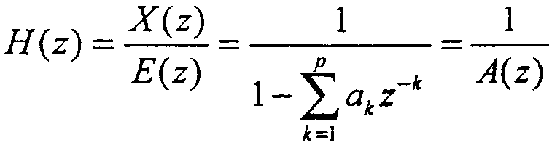
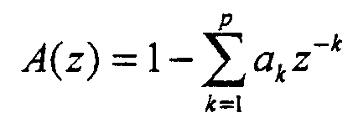
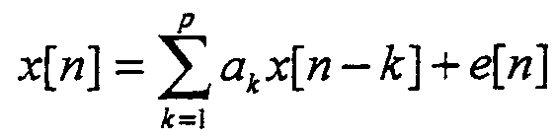
2.3 LINEAR PREDICTIVE CODING
We could model the filter H(Z) in Figure 6. 15 as
(6.19)
where p is the order of the LPC analysis.The inverse filter A(z) is defined as
(6.20)
Taking inverse z-transfonns in Eq. (6. 19) results in
(6.21)

Slide 29
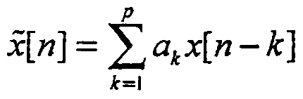
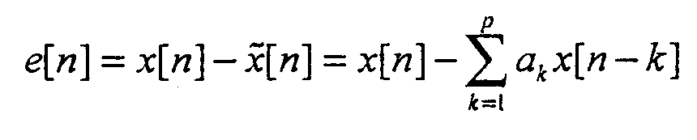
LPC (Linear predictive coding )
Linear predictive coding gets its name from the fact that it predicts the current sample as a linear combination of its past p samples:
(6.22)
The prediction error when using this approximation is
(6.23)

Slide 30
Solution of the LPC Equations
The solution of the Yule-Walker equations in Eq. (6.29) can be achieved with any standard matrix inversion package. Because of the special form of the matrix here, some efficient solutions are possible, as described below. Also, each solution offers a different insight so we present three different algorithms: the covariance method, the autocorrelation method, and the lattice method.

Slide 31
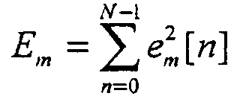
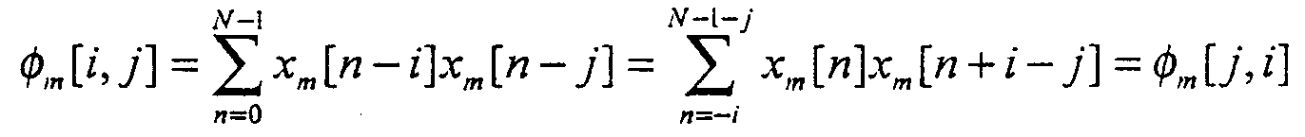
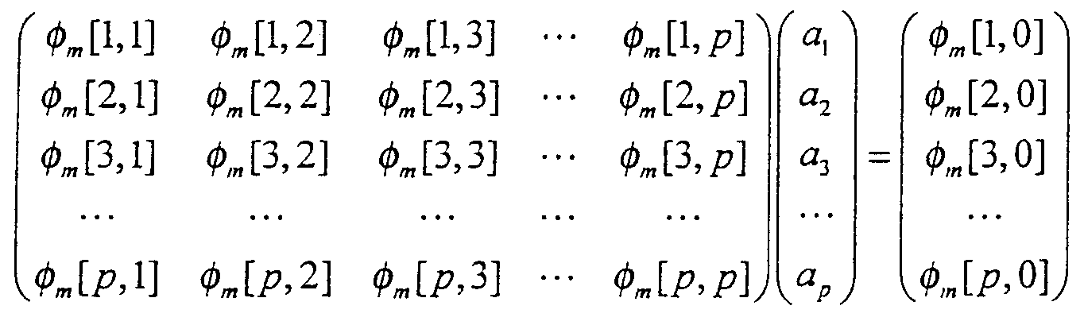
Covariance Method
(6.34)
so that Eq. (6.28) & Eq. (6.29) becomes
(6.35)
Eq.(6.29) becomes
(6.36)

Slide 32

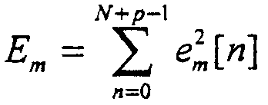
Autocorrelation Method
The summation in Eq. (6.28) had no specific range.We assume that χ_{m}[n] is 0 outside the interval 0≦n＜ N : (6.51)
with w[n] being a window (such as a Hamming window) which is 0 outside the interval 0≦n＜ N. With this assumption, the corresponding prediction error e_{m}[n] is non-zero over the interval 0 ≦ n ＜ N-p, and, therefore, the total prediction error takes on the value
(6.52)

Slide 33
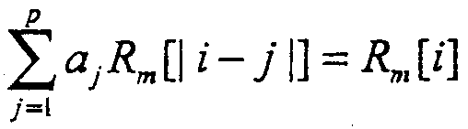
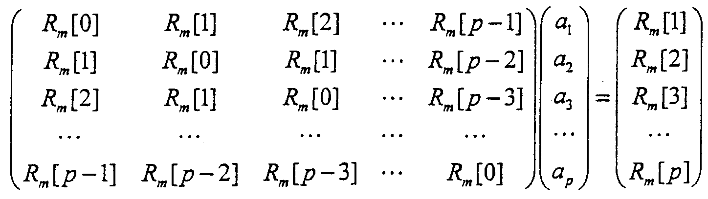
Combining Eqs.(6.54) and (6.29), we obtain
(6.56)
which corresponds to the following matrix equation
(6.57)

Slide 34
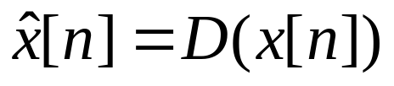


2.4 CEPSTRAL PROCESSING
A homomorphic transformation is a transformation that converts a convolution
(6.100)
into a sum
(6.101)
In this section we introduce the cepstrum as one homomorphic transformation.

Slide 35


. Homomorphic Signal Processing
Homomorphism is a way of “carrying over” operations from one algebra system into another.
Ex. convulution multiplication addition

Slide 36


For the system D*[．]
*
×
＋
＋
x[n]
Z[．]
Log[ ]
Z⁻¹[．]
X(Z)

Slide 37




y[n]= x [n]*h[n]
x[n]
*
D*[ ]
＋
＋
Linear Filter
＋
＋
D⁻¹*[ ]
*
由 y[n]= x [n]*h[n] 重建 x[n]

Slide 38
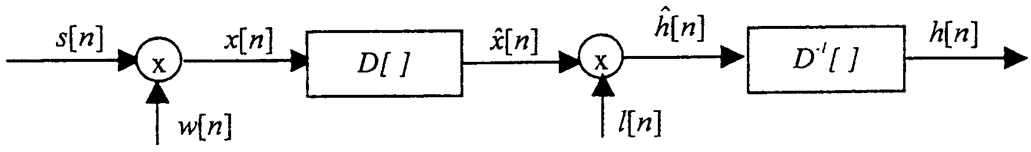




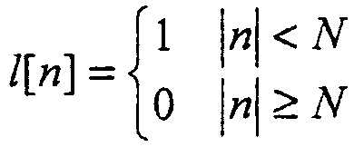
We can find a value N such that the cepstrum of the filter for , and that the cepstrum of the excitation for . With this assumption, we can approximately that allows us to separate the source from the filter.
(6.102)

Slide 39
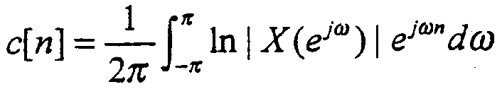
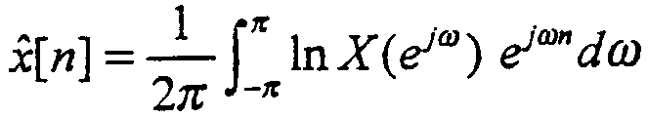


cepstrum = |ifft(log(|fft(frame)|))|
The real cepstrum of a digital signal x[n] is defined as
(6.104)
and the complex cepstrum of x[n] is defined as
(6.105)
where the complex logarithm is used:
(6.106)
and the phase is given by
(6.107)

Slide 40
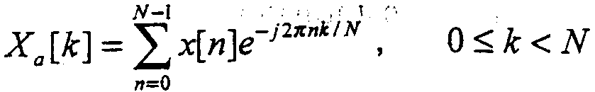
Mel-Frequency Cepstrum
The Mel-Frequency Cepstrum Coefficients (MFCC) is a representation defined as the real cepstrum of a windowed short-time signal derived from the FFT of that signal. The difference from the real cepstrum is that a nonlinear frequency scale is used.
Given the DFT of the input signal
(6.139)

Slide 41
Mel-frequency Wrapping
We know that human ears, for frequencies lower than 1 kHz, hears tones with a linear scale instead of logarithmic scale for the frequencies higher that 1 kHz.
The mel-frequency scale is a linear frequency spacing below 1000 Hz and a logarithmic spacing above 1000 Hz.
The voice signals have most of their energy in the low frequencies. It is also very natural to use a mel-spaced filter bank showing the above characteristics.

Slide 42
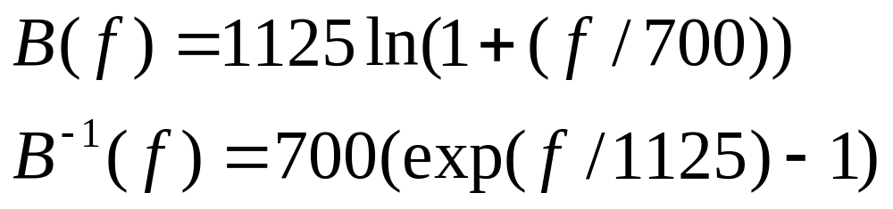

Slide 43
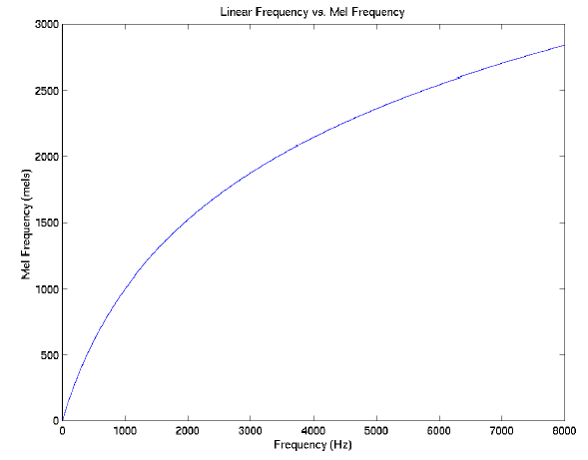
The mel-frequency scale is a linear frequency spacing below 1000 Hz and a logarithmic spacing above 1000 Hz.
For each tone with an actual frequency, f, measured in Hz, a subjective pitch
is measured on a scale called the ‘mel’ scale.
The pitch of a 1 kHz tone, 40 dB above the perceptual hearing threshold, is defined as 1000 mels.

Slide 44
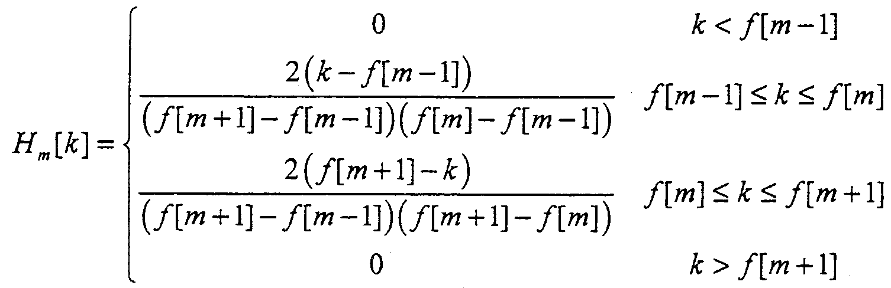
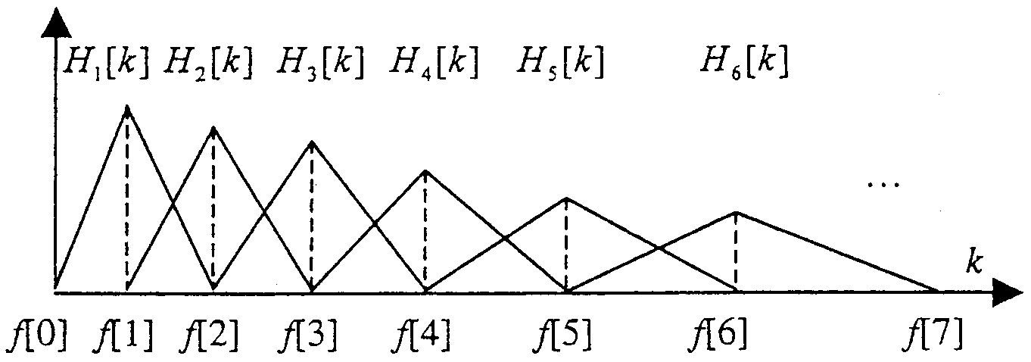
We define a filterbank with M filters (m = 1, 2, …, M ), where filter m is triangular filter given by:
(6.140)

Slide 45
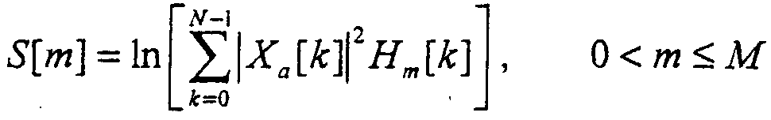
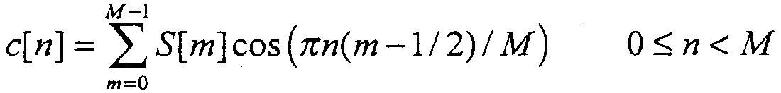
We then compute the log-energy at the output of each filter as
(6.144)
The mel-frequency cepstrum is then the discrete cosine transform of the M filter outputs:
(6.145)

Slide 46
Summary: steps to derive MFCCs
Step1: Take the Fourier transform of (a windowed excerpt of) a signal.
Step2: Map the powers of the spectrum obtained above onto the mel scale, using triangular overlapping windows.
Step3 Take the logs of the powers at each of the mel frequencies.
Step4 Take the discrete cosine transform of the list of mel log powers, as if it were a signal.
Step5 The MFCCs are the amplitudes of the resulting spectrum.

